Slide 1
What is your purpose? The purpose of this plugin is to facilitate clients to place order on a single click.
Where is the problem? Many customer ask us to provide delivery when they get order by phone call. Once they receive any order by phone, they call us to provide delivery. We call delivery boy and this is all manual.
Why you need it? This plugin will allow our clients to place order through nopCommerce and use our system rather than calling us manually.
What is your preferred solution? This is kind of one page checkout. The product will already be created in the system and will be joined with the vendor, store and warehouse through a defined table (slide2). The client (vendor) will see a front view shown in slide 3. He will place order and it will be processed normally.
What components is the problem with? This is ordering system problem. Following checkout process is hectic for our clients. They want one page where they write the necessary details and place order.
Do you want a change to the existing plugin or do you want a new plugin? This will be a new plugin
How soon do you want it done, what's your priority? As soon as possible.
What should be the name of the plugin: CutomizedOrder.Nop.Plugin.CustomizedOrder

Slide 2
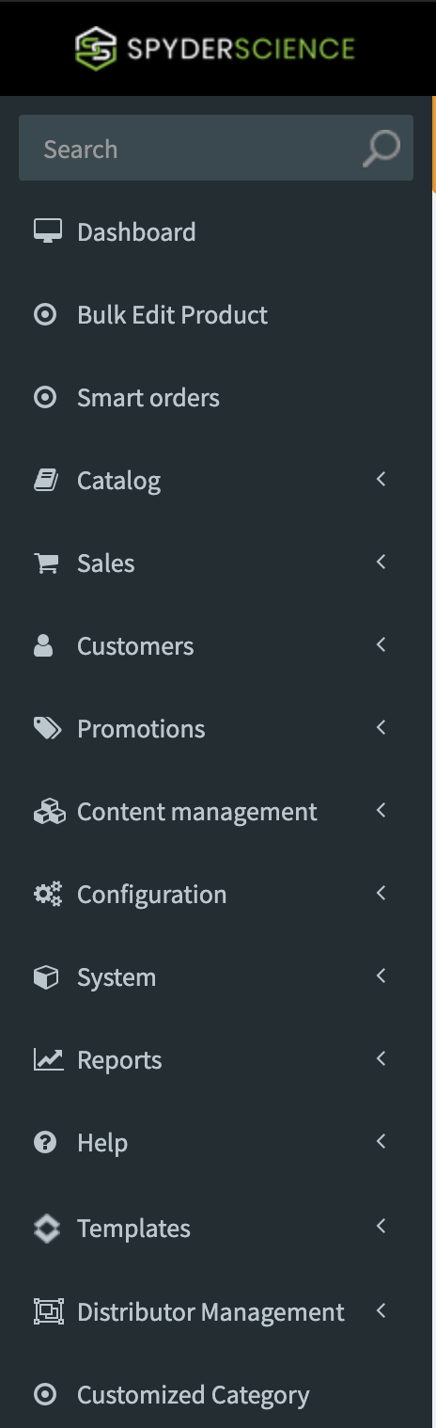
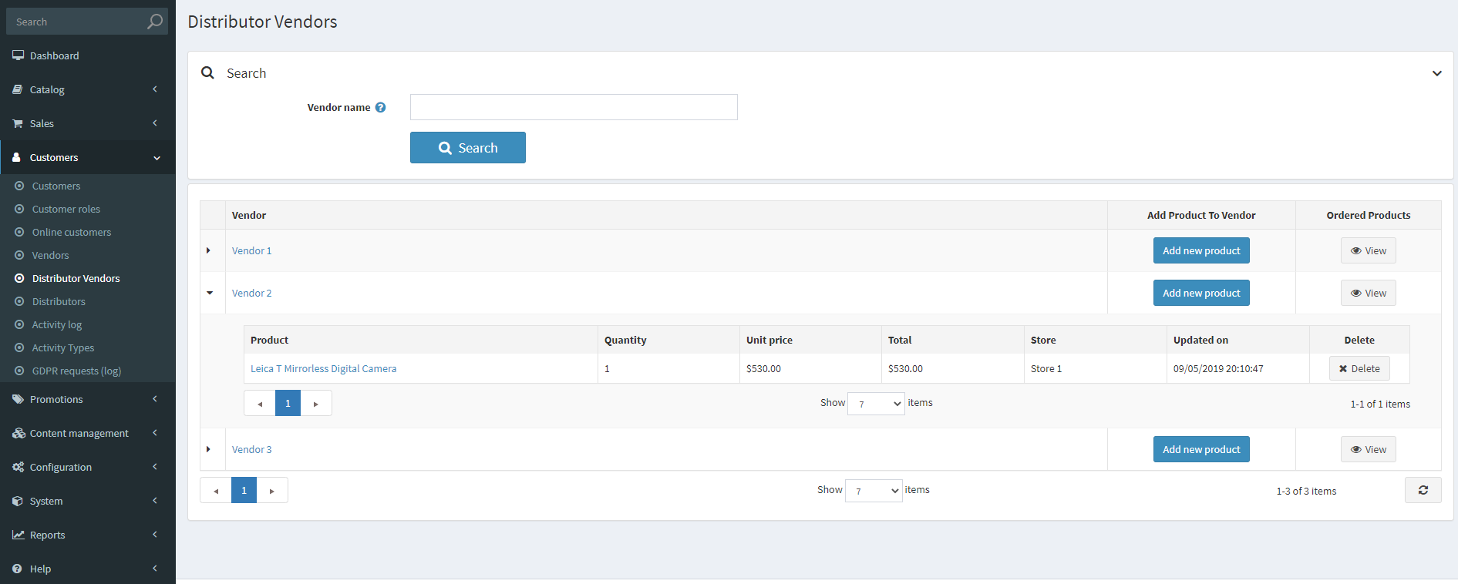

Custom delivery Settings
Registered Customers
These are guest customers associated with specific vendor, store and warehouse. Once edit button is pressed, it will show all fields including address fields allowed in “configuration > Settings > Customer Settings > Address form fields”.
Vendor name
Store name
Warehouse
 | Vendor name | Store name | Warehouse name | Associated customers | Phone # | ZIP, city | Edit
 | XYZ | ABC | DEF | John Smith | 1234567890 | N1R2S4, Paris
 | CDS | SDDS | DSFASLK | AHMED ALI | 2345465768 | D4F3S4, LYON
Store name
Edit
Edit
Custom delivery
settings
Add new
Delete selected
Custom delivery
order
Associated Product for Delivery
This table tell which product of a specific vendor, store and warehouse will be used for their delivery order.
Once edit button is pressed, it will all these fields in a new window.
Two Links
Vendor name
Store name
Warehouse
 | Vendor name | Store name | Warehouse name | Product SKU | Payment Method | Delivery Method | Edit
 | Saginaw Pharmacy | Saginaw Store | Saginaw Warehouse | PHR3123-3243-32 | Cash Plugin | Rapid Delivery
Edit
Add new
Delete selected

Slide 3
Custom delivery Settings
Registered Customers
Vendor name
Store name
Warehouse
 | Vendor name | Store name | Warehouse name | Associated customers | Phone # | ZIP, city | Edit
 | XYZ | ABC | DEF | John Smith | 1234567890 | N1R2S4, Paris
 | CDS | SDDS | DSFASLK | AHMED ALI | 2345465768 | D4F3S4, LYON
Store name
Add new button will allow admin to add new entry in this table. The entry will include these entries along with all address fields allowed in “configuration > Settings > Customer Settings > Address form fields”.
Edit
Edit
Custom delivery
settings
Add new
Delete selected
Custom delivery
order
Associated Product for Delivery
Two Links
Vendor name
Store name
Warehouse
 | Vendor name | Store name | Warehouse name | Product SKU | Payment Method | Delivery Method | Edit
 | Saginaw Pharmacy | Saginaw Store | Saginaw Warehouse | PHR3123-3243-32 | Cash Plugin | Rapid Delivery
Edit
Add new button will allow to add new entry in this table.
Add new
Delete selected

Slide 4
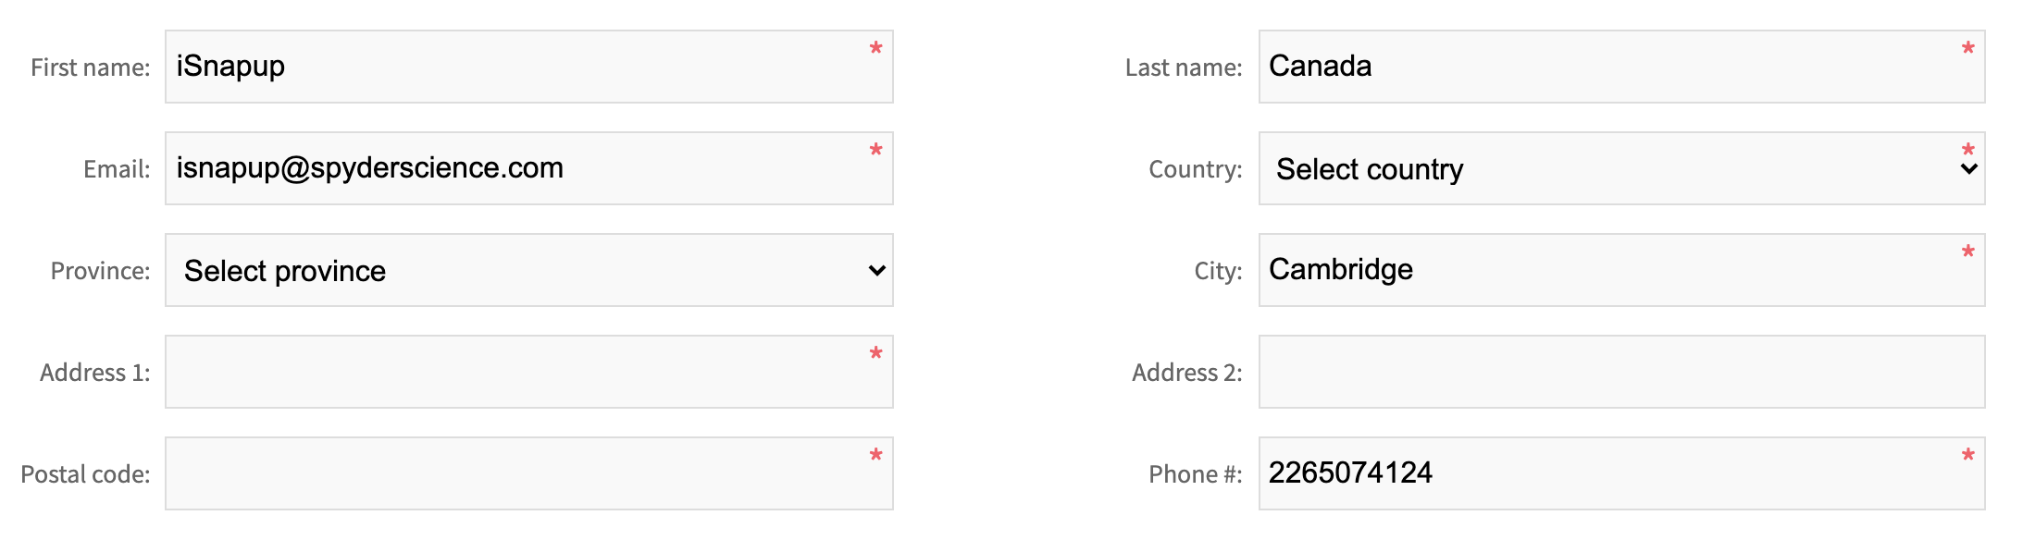
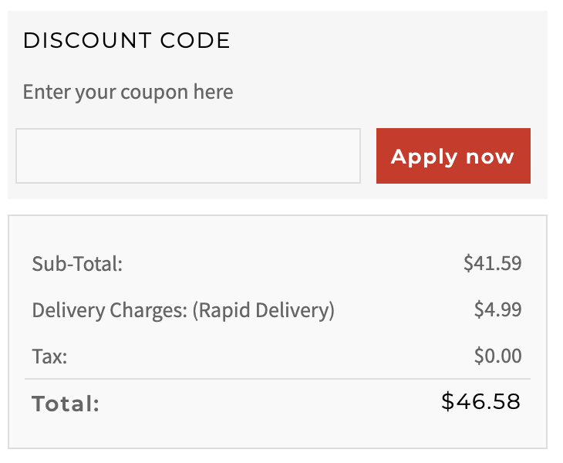
Make a Customer Delivery Order
THIS SLIDE IS REMOVED
Delivery Order
Search Customer:
These are the customers added at the admin side or they are returning customers: Either “Place order” or “Send Order to Customer Mobile” is already used.
VENDOR NAME
STORE NAME
Warehouse
Order Placement
Send Order to Customer Mobile
Search Name/Mobile
Search
Customer Details
Customer 1
Customer Details:
This detail is saved in customer table as a guest customer. All these fields are those one that are allowed in “configuration > Settings > Customer settings > Address form fields”.
Customer 2
Customer 3
Customer 4
Customer 5
Order Specifications
Total Order Cost:
Order details:
Order Specifications:
These are product attributes that we can define from the admin side: Catalog > Attributes > Product Attributes.
Delivery Specifications
TIP AMOUNT:
Delivery Instruction:
Delivery Specifications:
These are checkout attributes that we can define from the admin side: Catalog > Attributes > Checkout Attributes.
Place Order
Calculate Charges
Notes:
Remove Weight and Volume

Slide 5
Make a Customer Delivery Order
Delivery Order
Live Orders
Once live order is clicked, it will open a URL as:
https://[Store URL]/admin/smartorder
VENDOR NAME
STORE NAME
Warehouse
Order Placement
Send Order to Customer Mobile
Search Name/Mobile
Search
Customer Details
Customer Details:
This detail is saved in customer table as a guest customer. All these fields are those one that are allowed in “configuration > Settings > Customer settings > Address form fields”.
Order Specifications
Total Order Cost:
Order details:
Order Specifications:
These are product attributes that we can define from the admin side: Catalog > Attributes > Product Attributes.
Delivery Specifications
TIP AMOUNT:
Delivery Instruction:
Delivery Specifications:
These are checkout attributes that we can define from the admin side: Catalog > Attributes > Checkout Attributes.
Place Order
Calculate Charges
Notes:
Remove Weight and Volume

Slide 6
Make a Customer Delivery Order
Delivery Order
Live Orders
Search Customer:
These are the customers added at the admin side or they are returning customers: Either “Place order” or “Send Order to Customer Mobile” is already used for these customers. The dropdown is shown once search field is clicked/active.
VENDOR NAME
STORE NAME
Warehouse
Order Placement
Send Order to Customer Mobile
Search Name/Mobile
Search
Customer Details
Customer 1
Customer 2
Customer Details:
This detail is saved in customer table as a guest customer. All these fields are those one that are allowed in “configuration > Settings > Customer settings > Address form fields”.
Customer 3
Customer 4
Customer 5
Order Specifications
Total Order Cost:
Order details:
Order Specifications:
These are product attributes that we can define from the admin side: Catalog > Attributes > Product Attributes.
Delivery Specifications
TIP AMOUNT:
Delivery Instruction:
Delivery Specifications:
These are checkout attributes that we can define from the admin side: Catalog > Attributes > Checkout Attributes.
Place Order
Calculate Charges
Notes:
Remove Weight and Volume

Slide 7
Make a Customer Delivery Order
Delivery Order
Live Orders
VENDOR NAME
STORE NAME
Warehouse
Order Placement
Send Order to Customer Mobile
vendor enters the Address for the customer, it will auto populate their City, Province, Country and Postal Code automatically.
Search Name/Mobile
Search
Customer Details
Order Specifications
Total Order Cost:
Order details:
Place Order:
The order will be placed online directly with a pop-up confirmation message “Order has been placed”. Payment method and Delivery methods are defined in the admin table (slide 2).
Delivery Specifications
TIP AMOUNT:
Delivery Instruction:
Place Order
Calculate Charges
Notes:
Remove Weight and Volume

Slide 8
Make a Customer Delivery Order
Delivery Order
Live Orders
VENDOR NAME
STORE NAME
Warehouse
Order Placement
Send Order to Customer Mobile
Search Name/Mobile
Search
Customer Details
Order Specifications
Total Order Cost:
Order details:
Send Order to Customer Mobile:
Send this product along with the product details to customer mobile number as a Wishlist “You received a new Wishlist item in your cart. Please follow the link below: URL”. Nexmo sms service can be used.
Customer will add this product in his cart and follow the checkout process for address, payment, delivery and order placement.
Send Order to Customer Mobile
Notes:
Remove Weight and Volume

Slide 9
For the Custom Order Page: There is a button created beside “Place Order” called “Calculate Charges”
Functionality of “Calculate Charges” Button:
Basically, when the vendor enters the Address for the customer, it will auto populate their City, Province, Country and Postal Code automatically.
Then the vendor will proceed and click on the “Calculate Charges” button. Once clicked, it will calculate the delivery charges for that customer.
Purpose: The rationale for the “Calculate Charges” button is to quickly tell the customer the delivery charges. The vendor will be able to calculate and tell the customer on the phone the charges.
Other concerns when creating the “Calculate Charges” button:
Once you calculate the delivery charges from the “Calculate” button, If the vendor decides to click on the “Place Order” then an error msg will appear until he fills out the first name, last name of the customer.
Notes:
Remove Weight and Volume

